Slide 1

LiDAR based 3D Object Detection using Pointpillars on Intel NCS2 Edge Devices
Vijay Saravana Jaishanker
CS8903 - Special Problems - Final Presentation
Guide : Prof. Ling Liu

Slide 2
Progress
Date | Topic | Status
9/10 | Topic finalization - 3D object detection | Completed
9/20 | Prior Art analysis in 3D object detection and Dataset exploration - Kitti Dataset, NuScenes, Waymo Dataset | Completed
9/30 | Implementation of 3D object detection using LiDAR point clouds and Camera data to visualize using GPU | Completed
10/12 | Simulation of real time 3D object detection and measuring frame drops | Completed
11/05 | Using Intel NCS 2 to run open Vino IR pre-trained models and running 3D object detection model on single stick | Completed
11/18 | Trying 3D bounding box with OpenPCDet codebase | Completed
12/03 | Running 3D object detection model on multiple NCS devices | Completed
12/05 | Synchronizing the parallel inference outputs from NCS devices | Completed
12/08 | mAP evaluation and other metrics for 3D object detection model | Completed

Slide 3
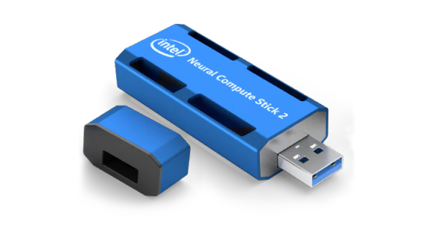
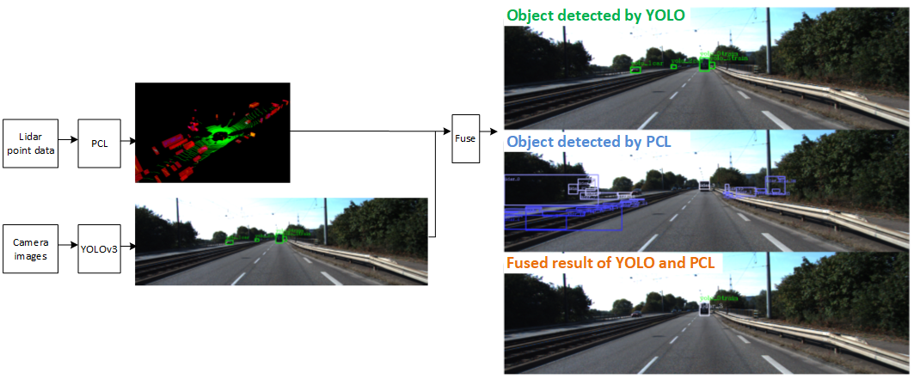

Pipeline of model inference
Inference on Intel NCS2
PCL Object Detection
Data Preprocessing
(Reduced Point Cloud Data)
PCL Object detection based on PointPillars thread
Detection
Results
&
NMS Post Processing
LiDAR Point Cloud Data
Bounding Box Module
Fusion Module
Voxel Generation
Pillar Extraction
(PFE)
Region Proposal
(RPN)
LiDAR 3D bounding box
Intersection
Over
Union
Module
YOLO Object Detection
Threshold
BBox
Module
Inference on Intel CPU
Data Preprocessing
YOLO v3 Object Detection Thread
Camera Data
Detection
Results
Anchor Feature Extraction
Conv Detectors
Camera 2D
Bounding Box
Notes:
Data Preprocessing : Performs encoding and padding
PCL

Slide 4

Lidar-based 3D Object Detection Inference Model
Voxel Generation: Convert point cloud pixel data into stacked pillars tensor (voxels) and pillar index tensor.
Pillar Feature Extraction (PFE): Use the stacked pillars to learn features.
Scattering : Project the center point of the object in 3D point cloud (PCL) onto the 2D image (Pseudo Image).
Region Proposal Network (RPN): Using a 2D CNN to extract features from pseudo-image.
3D Bounding Box Prediction : Filter box with NMS algorithm.
NMS Algorithm: Non-Maximum suppression algorithm - Compare proposal with every other proposal and remove if IOU (Intersection over Union) is less than certain threshold.

Slide 5
Fusion Inference Model
IOU YOLO vs LiDAR: Evaluate whether the distance between this point and the position center of the object detected by YOLO is greater than a certain threshold.

Slide 6
LiDAR Based 3D Object Detection
We will focus on LiDAR data since it aids in identifying depth hence helping solve 3D Object detection problem as compared to Camera only Object detection.
Point Cloud Data to create 3D image reconstruction of environment.
Highest mAP prevails for LiDAR based techniques.
Atleast for L5 autonomy, LiDAR remains most necessary today for safety purpose.
Nighttime vision - LiDAR works best.
Pedestrian tests failed for Camera based object detection.

Slide 7
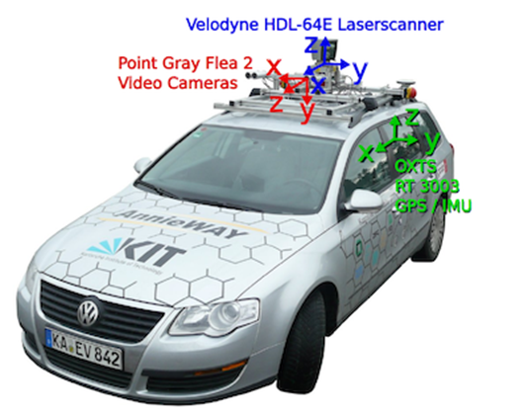
KiTTi Dataset
We will be using the KiTTi dataset curated by Toyota AV Research institute.
7481 training scenes and 7581 test scenes and each scene ~500 frames.
LiDAR data is captured by performing a 100ms 360 degree scan of the surrounding using the velodyne sensors (LiDAR spins at 10 fps).
Resolution: 1382 x 512

Slide 8
Dataset Comparisons
Dataset Name | Paper | URL | Scenes | Resolution | Video length | FPS
KITTI (Toyota) | Link | Link | 22 | 1382 x 512 | 15 s | 10 fps (LiDAR)
NuScenes (Motional) | Link | Link | 1000 | 1600x1200 | 20 s | 12 fps (Cameras) 20 fps (LiDAR)
Waymo (Google) | Link | Link | 1000 | 641 × 961 | 20 s | 10 fps
Top 3 datasets most widely used and most comprehensive.
Other important ones include Lyft, Audi A2D2 etc

Slide 9
Prior Art Comparisons
Paper | Modality | Backbone NN Algorithm | Open Source link | Dataset | Train/ Test split | Inference Time/ FPS | mAP
EVA (2021) | Camera | YOLO | Link | ETH-Sunnyday | 70/30 | 14 fps | 86.9
ComplexYOLO (2018) | Lidar | YOLOv2 + ERPN | Link | KITTI | 85/15 | 30 fps (Nvidia 1060) 2 fps on i7 10th gen CPU | 54.33
PointPillars (2019) | Lidar | 2D CNN | Link | Kitti/ NuScenes | 50/50 | 62 fps (GPU) | 66
Contfuse (2018) | Lidar + Camera | ResNet18 | Link | KITTI | 50/50 | 16 fps | 70
Center Point (2021) | Lidar | VoxelNet/ PointPillars | Link | NuScenes/ Waymo | 60/40 | 11 fps (Waymo), 16 fps (NuScenes) | 68.8
Notes:
LiDAR + Camera for Occluded objects (2 fuse into 1)

Slide 10
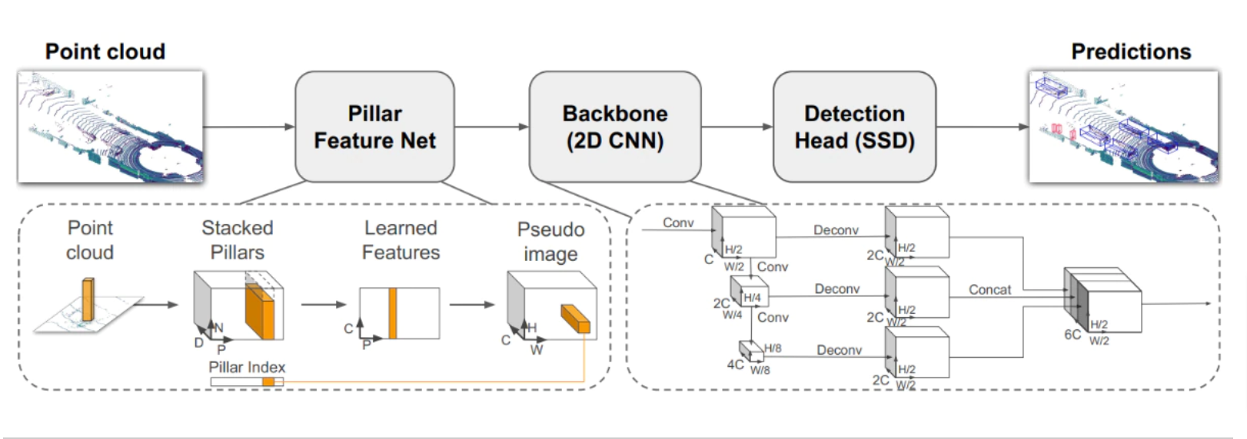
OpenVINO optimization for 3D object detection
Reference - PointPillars: Fast Encoders for Object Detection from Point Clouds

Slide 11
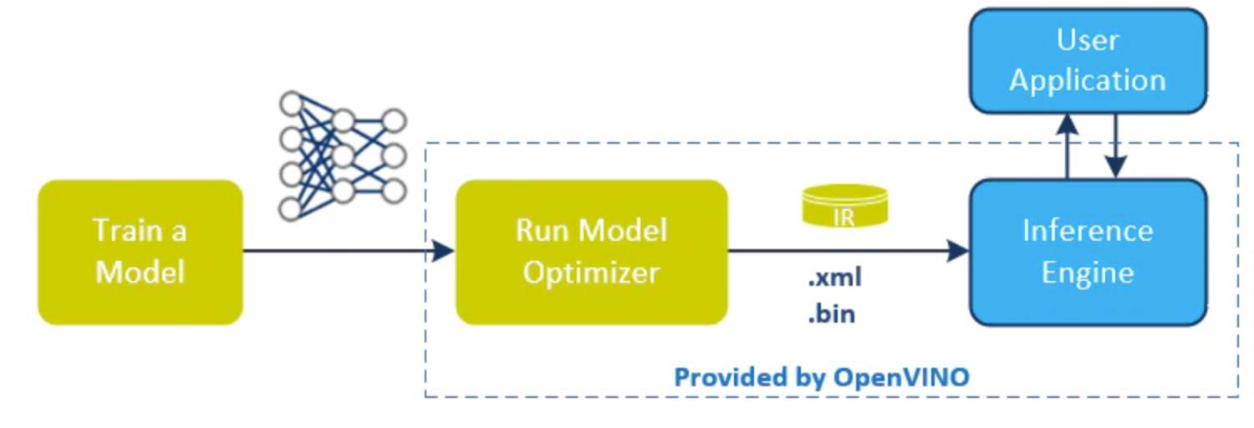
OpenVINO optimization
OpenVINO toolkit for AI model optimization by reducing resource demands.
From a Pytorch model, we can get the intermediate reference model which can run on intel devices.
Creates .xml and .bin files which holds the NN architecture and weights.

Slide 12
OpenVINO based Implementation for Intel NCS2 Stick
Using point pillars on 3D LiDAR data, Intel has published a paper for Intel CPUs and GPUs. https://ieeexplore.ieee.org/document/9524176
Modified the model to run on Intel NCS 2 device by reducing the overall memory needed to load the model.
Initially this did not fit in the memory of Intel NCS 2 which has 2.5 MB on-chip memory.
We have to load 2 models :
Pillar Feature Extractor (PFE) (Use point pillars to learn features)
Regional Proposal Network (RPN) (Use CNN to extract features from 2D pseudo image)
PFE model did not fit in the Intel NCS stick.

Slide 13
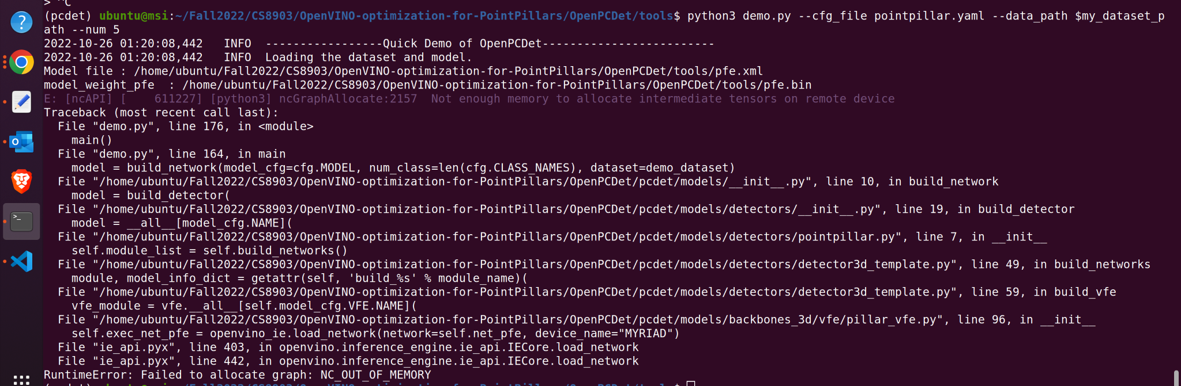
Errors faced
OUT_OF_MEMORY error while trying to load the model into Intel NCS 2.
Intel NCS 2 has a memory size of 2.5 MB. The point pillars model was large and this could not fit in the NCS device.
Decreased the number of stacked Pointpillars voxels gradually from 12000 to 100 in steps.

Slide 14
OpenVINO based Implementation for Intel NCS2 Stick
After reducing the number of pointpillar features (voxels), we were able to fit the IR (intermediate representation) model into the Intel NCS2 Device! Although this meant a performance issue which we will see next.
We used the github link from intels repository as reference for the implementation.
We prepared the dataset as mentioned in the Smallmunich repo to create the reduced version of the dataset from kitti dataset.
Code modified to optimize for Intel NCS2 Myriad stick as the code supports only intel CPUs and GPUs.
Code implementation can be found in Github and in Dropbox.

Slide 15
PointPillars model
We will be using pointpillars pretrained model from OpenPCDet repository.
The model configuration can be seen in the pointpillar.yaml file.
As you can see from the file, the NMS threshold for 3D bounding box is set to 0.1 and learning rate is set to 0.003 with Adam optimizer.
Train test split of 50/50 is used for the model.

Slide 16
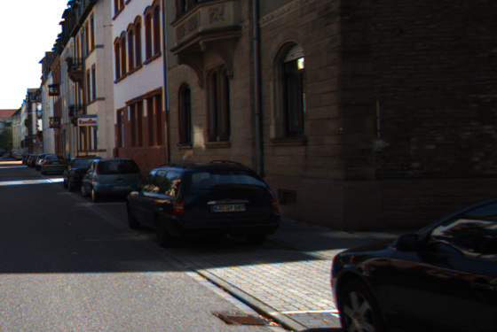
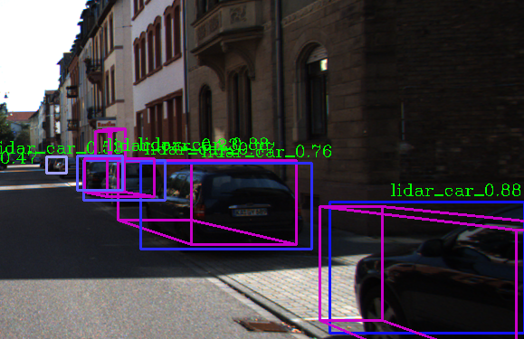
Sample output Frame
Original Frame
3D Object Detection showing class name and confidence

Slide 17
Steps to load and run models on Intel NCS2
Step 1: Install OpenVINO toolkit for linux as shown here.
Step 2: Configure NCS2 stick USB rules as shown here.
Step 3: If you have an existing model, you can use the Model Optimizer to convert the model to intermediate Representation (IR) to run on NCS.
Step 4: Output of the MO will be .xml and .bin files which contain the neural network weights and architecture.
Step 5: Use ‘lsusb’ command to check if the MYRIAD device is seen.
Step 6: We will use the OpenPCDet codebase to perform the MO for OpenVINO.

Slide 18
Comparing with Fast EVA Project
Lidar based 3D Object Detection | Fast EVA
Our project works with LiDAR data as well as Image data to perform the predictions. The final predictions produce 3D bounding boxes over the identified objects. This is crucial in the AV domain. | Fast EVA is based on pretrained YOLO and SSD models which perform 2D object detection. They work with Image data only to perform predictions. The final predictions produce 2D bounding boxes over objects identified.

Slide 19
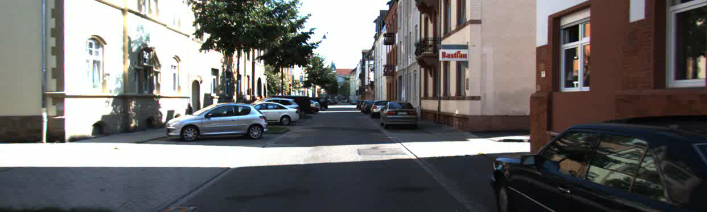
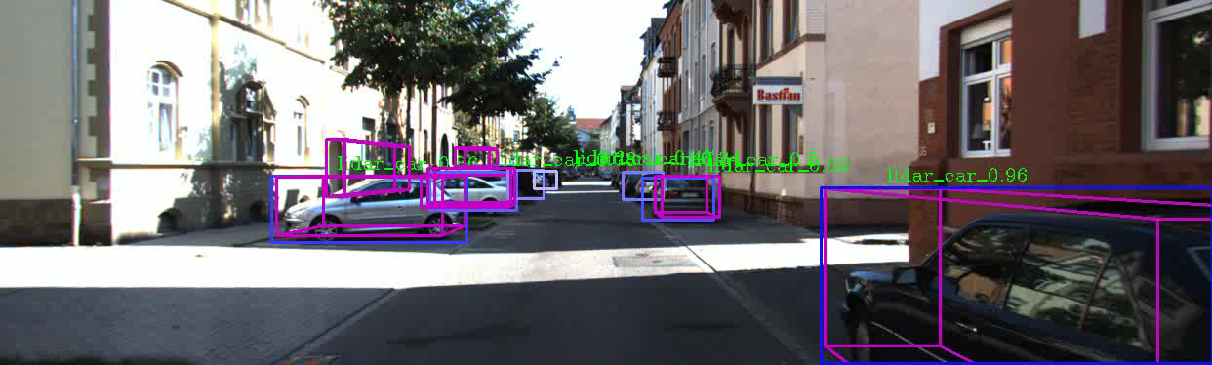
Model Performance
Video 1 : Raw input video
FPS : 10
Video 2 : Intel CPU based offine detection using OpenVINO
FPS : 10
mAP : 26.33

Slide 20
Model Performance – Offline Detection
Video 1 : Model Running on a single NCS2 Stick
FPS : 0.33
mAP : 25.09
Video 2 : Model Running on two NCS2 Sticks
FPS : 0.65
mAP : 26.12

Slide 21
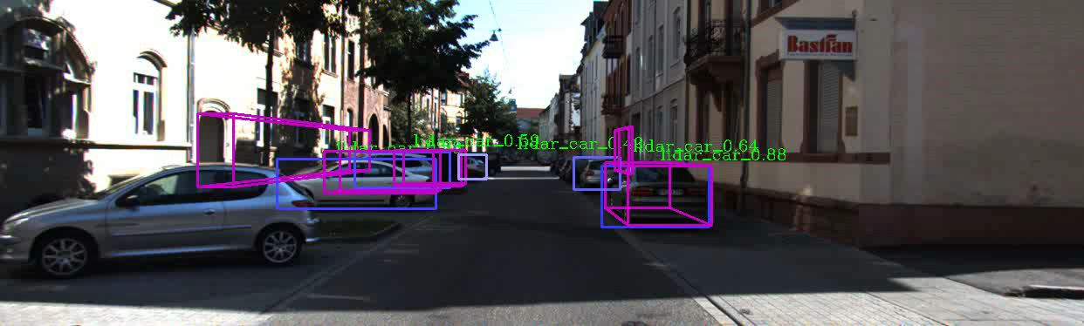
Model Performance – Online Detection with Frame Dropping
Video 1 : Model Running on a single NCS2 Stick
FPS : 0.32
Video 2 : Model Running on two NCS2 Sticks
FPS : 0.66

Slide 22
Model Performance
We can see that the model performs well ~58.97 mAP (mean Average Precision for Car/easy and 26.06 mAP overall.
According to the KiTTi dataset, easy is characterized by large bounding boxes and less occlusion and obstacles for object detection.
Type
 | Easy | Medium | Hard
Car | 58.97 | 10.51 | 6.49
Cyclist | 27.27 | 18.18 | 18.12
Pedestrian | 54.54 | 27.27 | 18.11
Class Label

Slide 23
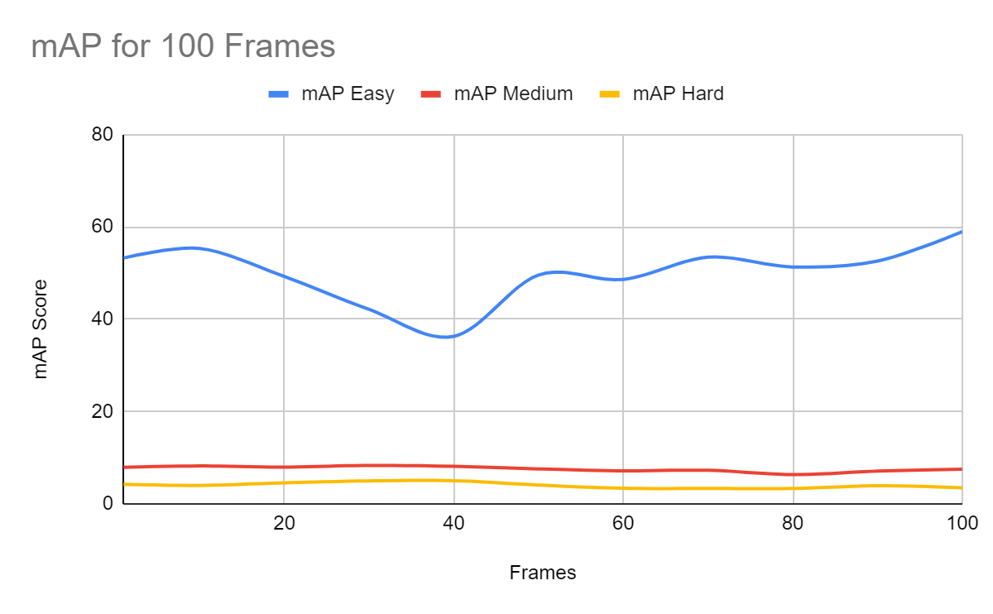
Model Performance
As the complexity increases (small/ distant object with obstacles) or for less common objects like cyclists - our model struggles to perform.

Slide 24
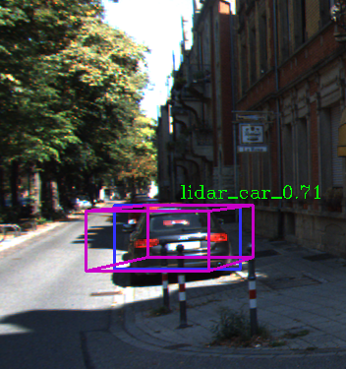
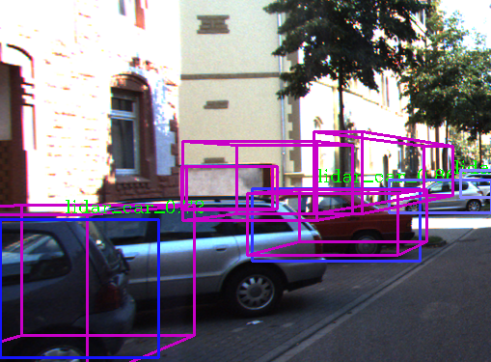
Model Performance
Example of Easy scene (Less occlusion
and big bounding box)
Example of Hard (More occlusion/ blocking and many small bounding box)

Slide 25
Conclusion
Our model performs well for easy car scenes in the KiTTi dataset with a mAP of 58.
This is a pretty good score considering we have significantly reduced the number of voxels/ features from 12000 to 100 in a stacked pointpillar to fit the model into Intel NCS Myriad stick.
The overall mAP is however low (~26) due to the class imbalance in the training data - most of the scenes contain cars and the occurrence of pedestrians and cyclists are less.
We will be able to fix this by using data imbalance handling algorithm like SMOTE algorithm.
More information on 3D object detection performance can be seen in my tech review.

Slide 26
Conclusion
LiDAR detects all the obstacles, and we can see a lot of false positives – these can be removed/ optimized by tuning the inference by adjusting various parameters by running experiments.
We will further tweak the model inference by playing around with NMS thresholds, number of features etc. to improve the model performance.
We can see that the model inference time improves ~2x when another NCS2 device is added. This is possible due to OpenVINO optimization for multi stick configuration. We will experiment with more devices in the future as shows in EVA paper.

Slide 27
Open-Source Code References
OpenPCDet : https://github.com/open-mmlab/OpenPCDet
Fast EVA : https://github.com/git-disl/EVA
Intel OpenVINO Pointpillars : https://github.com/intel/OpenVINO-optimization-for-PointPillars
Nutomy Pointpillars : https://github.com/SmallMunich/nutonomy_pointpillars

Slide 28
References
[1] R. Girshick, J. Donahue, T. Darrell, and J. Malik. Rich feature hierarchies for accurate object detection and semantic segmentation. In The IEEE Conference on Computer Vision and Pattern Recognition (CVPR), 2014.
[2] K. He, G. Gkioxari, P. Dollar, and R. Girshick. Mask R-CNN. In ´ The International Conference on Computer Vision (ICCV), 2017.
[3] S. Ren, K. He, R. Girshick, and J. Sun. Faster R-CNN: Towards real-time object detection with region proposal networks. In Neural Information Processing Systems (NeurIPS), 2015.
[4] Arsalan Mousavian et al. “3d bounding box estimation using deep learning and geometry”. In: Proceedings of the IEEE Conference on Computer Vision and Pattern Recognition. 2017, pp. 7074–7082.
[5] Wang, Yue, Vitor Campagnolo Guizilini, Tianyuan Zhang, Yilun Wang, Hang Zhao, and Justin Solomon. "Detr3d: 3d object detection from multi-view images via 3d-to-2d queries." In Conference on Robot Learning, pp. 180-191. PMLR, 2022.
[6] Peng, Xidong, Xinge Zhu, Tai Wang, and Yuexin Ma. "Side: Center-based stereo 3d detector with structure-aware instance depth estimation." In Proceedings of the IEEE/CVF Winter Conference on Applications of Computer Vision, pp. 119-128. 2022.
[7] Zhou, Yin, and Oncel Tuzel. "Voxelnet: End-to-end learning for point cloud based 3d object detection." In Proceedings of the IEEE conference on computer vision and pattern recognition, pp. 4490-4499. 2018.

Slide 29
References
[8] Yin, Tianwei, Xingyi Zhou, and Philipp Krahenbuhl. "Center-based 3d object detection and tracking." In Proceedings of the IEEE/CVF conference on computer vision and pattern recognition, pp. 11784-11793. 2021.
[9] Alex H. Lang et al. “PointPillars: Fast Encoders for Object Detection from Point Clouds” Lang, Alex H., Sourabh Vora, Holger Caesar, Lubing Zhou, Jiong Yang, and Oscar Beijbom. "Pointpillars: Fast encoders for object detection from point clouds." In Proceedings of the IEEE/CVF conference on computer vision and pattern recognition, pp. 12697-12705. 2019.
[10] Ali, Waleed, Sherif Abdelkarim, Mahmoud Zidan, Mohamed Zahran, and Ahmad El Sallab. "Yolo3d: End-to-end real-time 3d oriented object bounding box detection from lidar point cloud." In Proceedings of the European conference on computer vision (ECCV) workshops, pp. 0-0. 2018.
[11] Li, Zhichao, Feng Wang, and Naiyan Wang. "Lidar r-cnn: An efficient and universal 3d object detector." In Proceedings of the IEEE/CVF Conference on Computer Vision and Pattern Recognition, pp. 7546-7555. 2021.
[12] Peng, Liang, Fei Liu, Zhengxu Yu, Senbo Yan, Dan Deng, Zheng Yang, Haifeng Liu, and Deng Cai. "Lidar point cloud guided monocular 3d object detection." In European Conference on Computer Vision, pp. 123-139. Springer, Cham, 2022.
[13] Liang, Ming, Bin Yang, Yun Chen, Rui Hu, and Raquel Urtasun. "Multi-task multi-sensor fusion for 3d object detection." In Proceedings of the IEEE/CVF Conference on Computer Vision and Pattern Recognition, pp. 7345-7353. 2019.

